Slide 1
Microbiome working group
Goal: work on microbiome data sets with support from colleagues

Slide 2
Microbiome data
Amplicon data - 16S rRNA, 18S rRNA, ITS markers
provides a snapshot of the taxonomic diversity
can process a lot of samples cheaply
not good for species and strain level identification
can be biased based on primer choice, sample preservation methods, and other technical artifacts
Shotgun metagenomic data
provides taxonomic and functional profiles
can provide strain level taxonomy information
expensive, requires a lot of DNA compared to amplicon methods
But, high-throughput, shallow coverage shotgun profiling is where the field is going
Notes:
Reading: preservation methods, Song et al.

Slide 3
Databases and tools for amplicon data
QIITA & EMP – microbiome specific
SRA & EBI – national/continental initiatives
QIIME – qiime.org
MOTHUR – www.mothur.org
R (e.g. Phyloseq), and other general stats software
Notes:
QIIME & Mothur both have really good documentation and active help forums. For the QIIME forum, there is a rotation in the lab with one person in charge for 2 week stints, must respond within 24 hours to each post.

Slide 4
Metadata – so tedious, so important
QIITA - https://qiita.ucsd.edu/
Step 1: upload your metadata and sequence data into QIITA.
why? It will keep you organized, can process data with a click of a button, allows you to do meta analysis with published data without downloading the data, and easily upload to EBI.
https://qiita.ucsd.edu/static/doc/html/tutorials/index.html

Slide 5
Metadata – so tedious, so important
Let’s take a minute to download the example meta data sheets
sample template
prep template
https://qiita.ucsd.edu/static/doc/html/tutorials/index.html

Slide 6
QIIME – Quantitative Insights Into Microbial Ecology
Open source software developed using python programming language.
Extremely useful for processing sequence data
Useful for many analyses as well, wraps quite a few R packages, avoiding reformatting for R.
Shotgun sequence process pipeline should be available early 2017

Slide 7
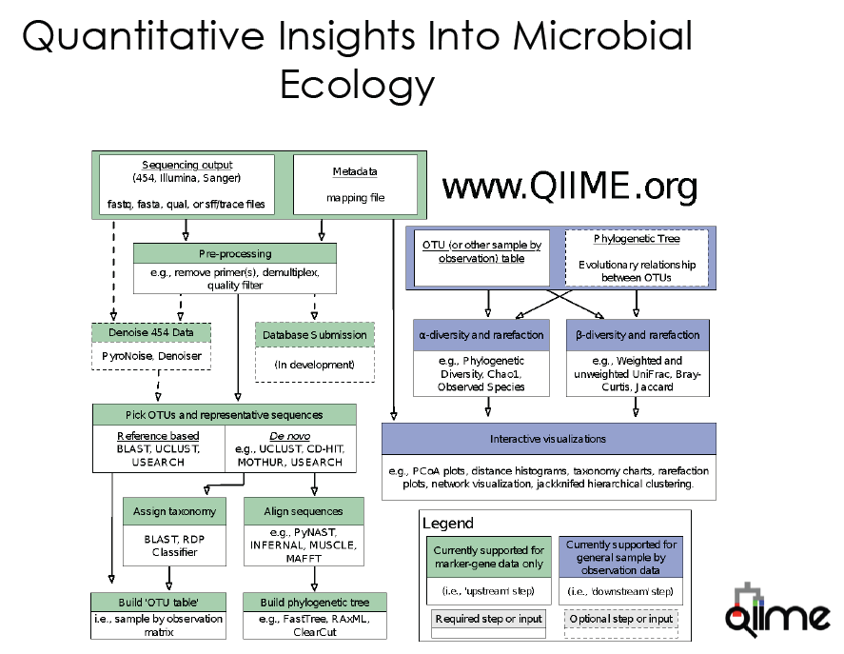
Command line
server vs. laptop

Slide 8
QIIME – Quantitative Insights Into Microbial Ecology
QIIME installation
http://qiime.org/install/install.html
anaconda/miniconda virtual environments, helps you avoid conflicts for dependencies used by multiple programs. And allows you to have multiple versions of the same software e.g. QIIME 1.9 and 2.0 alpha

Slide 9
What are your goals this semester?
What type of project do you have?
What are your questions?
What is your sample size?
How was your data generated?

